Slide 1
21- Generator Expressions

Slide 2
context
generator object 3
Ex.1 4
How you can get the size of an object? 5
Ex.2 6
List object size vs generator object size 7
len(generatorObject) : error | built in function 8

Slide 3


generator object
This is perfectly fine;
but there are situations that you might be working with a
really large dataset or
perhaps an infinite stream of data
In those situations,
you shouldn't store all those values in the memory
because that's very memory inefficient.
it’s more efficient to use a generator object

Slide 4

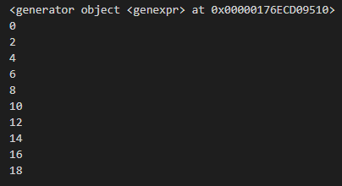
Ex.1
generator objects are iterable.
So just like lists, we can iterate over them. And in each iteration it generate or spit out a new value. So unlike lists, they don't store all the values in memory, they generate a new value in each iteration.

Slide 5

How you can get the size of an object?
112 byte

Slide 6

Ex.2
The size of this generator object remains consistent.

Slide 7
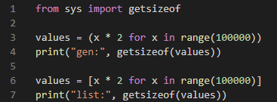

List object size vs generator object size
in situations where you're dealing with a really large dataset or potentially an infinite stream of data, use a generator expression to create a generator object
So when we use parenthesis around the comprehension expression, just be aware that because generator objects don't store all the items in memory, you won't be able to get the total number of items you’re working with

Slide 8

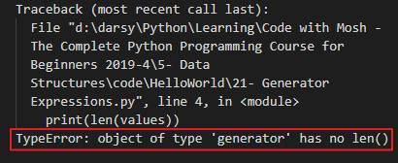
len(generatorObject) : error | built in function
because we can only access these items, these values when we iterate over a generator object, So we won't know ahead of time how many objects or how many items this generator is going to produce

